Slide 1
CarMax Analytics Showcase What Makes a Loyal Customer?
By: Nate Smith

Slide 2
Table of Contents
Setting the Scene
Machine Learning
Analysis
Suggestions

Slide 3
Missing Data
The data set contained a total of 361559 rows of data
The set was also missing data in 4 different features
Purchase price: missing 3 records
Distance to dealer: missing 6162 records
Customer Income: missing 49091 records
Post Satisfaction Survey: missing 360340 records
Rows with missing data was omitted when analyzing features
The full data set showed approximately 34% of buyers ended up having a subsequent purchase

Slide 4
Data Set Distributions

Slide 5
Data Distributions

Slide 6
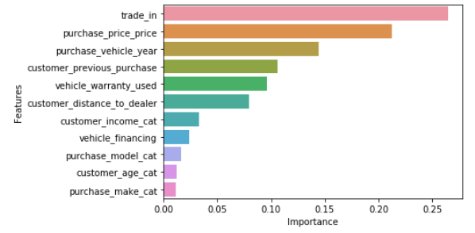
Machine Learning
Random Forrest machine learning using all the features was leveraged
Branching algorithms can tell us feature importance's
Feature importance's tell which features were the most influential on predictions and can help narrow analysis

Slide 7
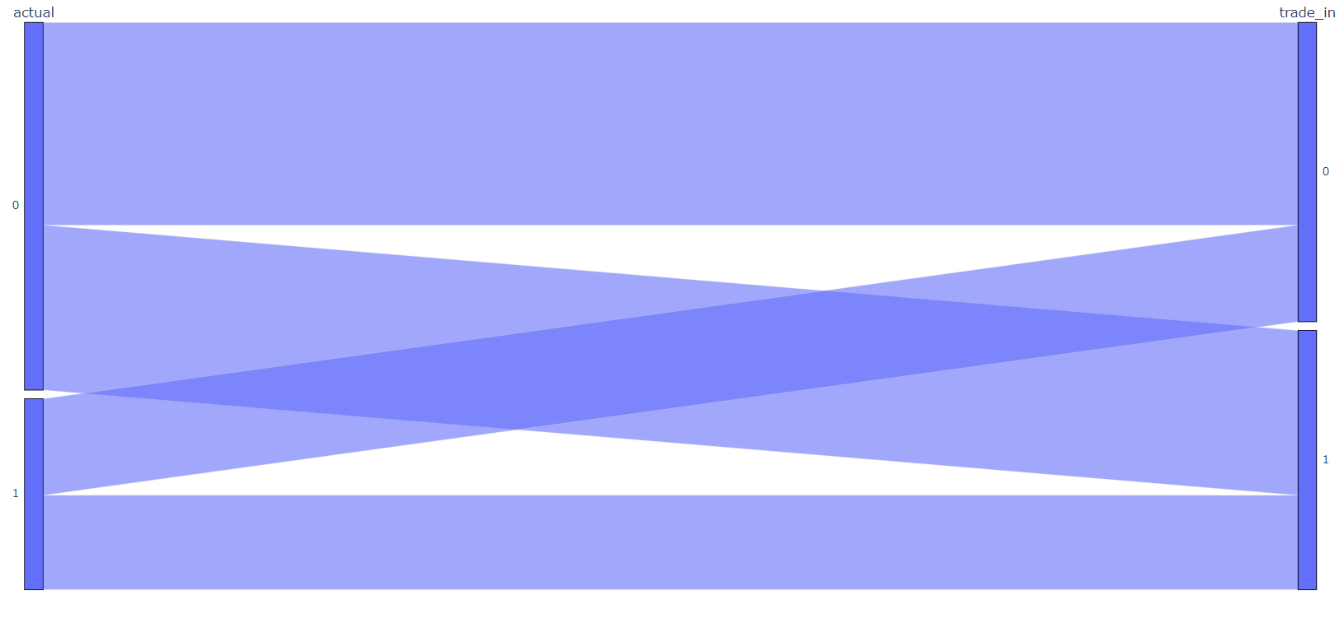
Trade In
49% of subsequent purchasers trade in while 41% of non subsequent purchasers trade in.
32% of non trade in will become a subsequent buyer while 36% of those who trade in will become a subsequent buyer

Slide 8
Year vs Trade In
Older cars that are traded in have a significantly larger difference in subsequent buyer ratio than newer cars (difference >= 7% as apposed to 4% difference in trade in ratio) exception is 2014

Slide 9
Income vs Trade In
There seems to be an obvious trend of growing separation with higher income and trade ins vs lower income and no trade in

Slide 10
Price vs Trade In
No obvious trend, however low priced cars with trade in shows great separation, confirms old year trend from prior graph. Some upper mid tier priced cars could show repeat purchasers of newer cars
Even numbers show a great lacking of data

Slide 11
Purchase Price Feature Analysis
Very low and high priced vehicles have more frequent subsequent purchases

Slide 13
Distance
There seems to be no real correlation with of subsequent buyers with distance (this trend stays true through warranty, previous purchase, and trade in), it is worth noticing the very high rate of subsequent buyers for people within a mile

Slide 14
Purchase Make
Most makes fall around the average, however specialty cars seem to have higher rates of subsequent buyers

Slide 15
Low Demand
Low demand cars have an average subsequent buyer rate of 36% as opposed to the population average of 34%. Not very significant but could be worth seeing what make the subsequent purchase was
Make | Count | LOTUS | 4
BENTLEY | 2 | MASERATI | 2
DAEWOO | 1 | MERCURY | 1801
EAGLE | 1 | OLDSMOBILE | 47
FIAT | 802 | PLYMOUTH | 8
GEO | 12 | PORSCHE | 1063
HUMMER | 782 | SAAB | 25
ISUZU | 66 | SMART | 684
JAGUAR | 650 | SUZUKI | 1320
LAND ROVER | 1093 | VOLVO | 1700

Slide 16
Purchase Make, Financing (y/n)
Customers who are buying more high end vehicles without financing ( I.e. hummer, audi, bently, jaguar, porche, pontiac) seem to have higher subsequent buyer rates

